Slide 1
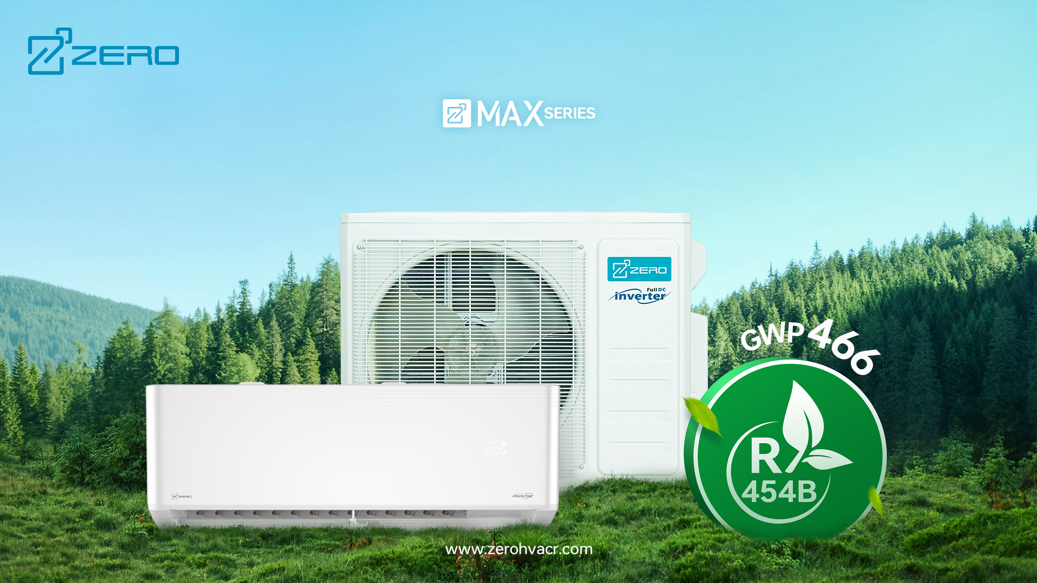

Z-MAX US Hyper Heat R454B Series
Notes:
Meets your needs

Slide 2
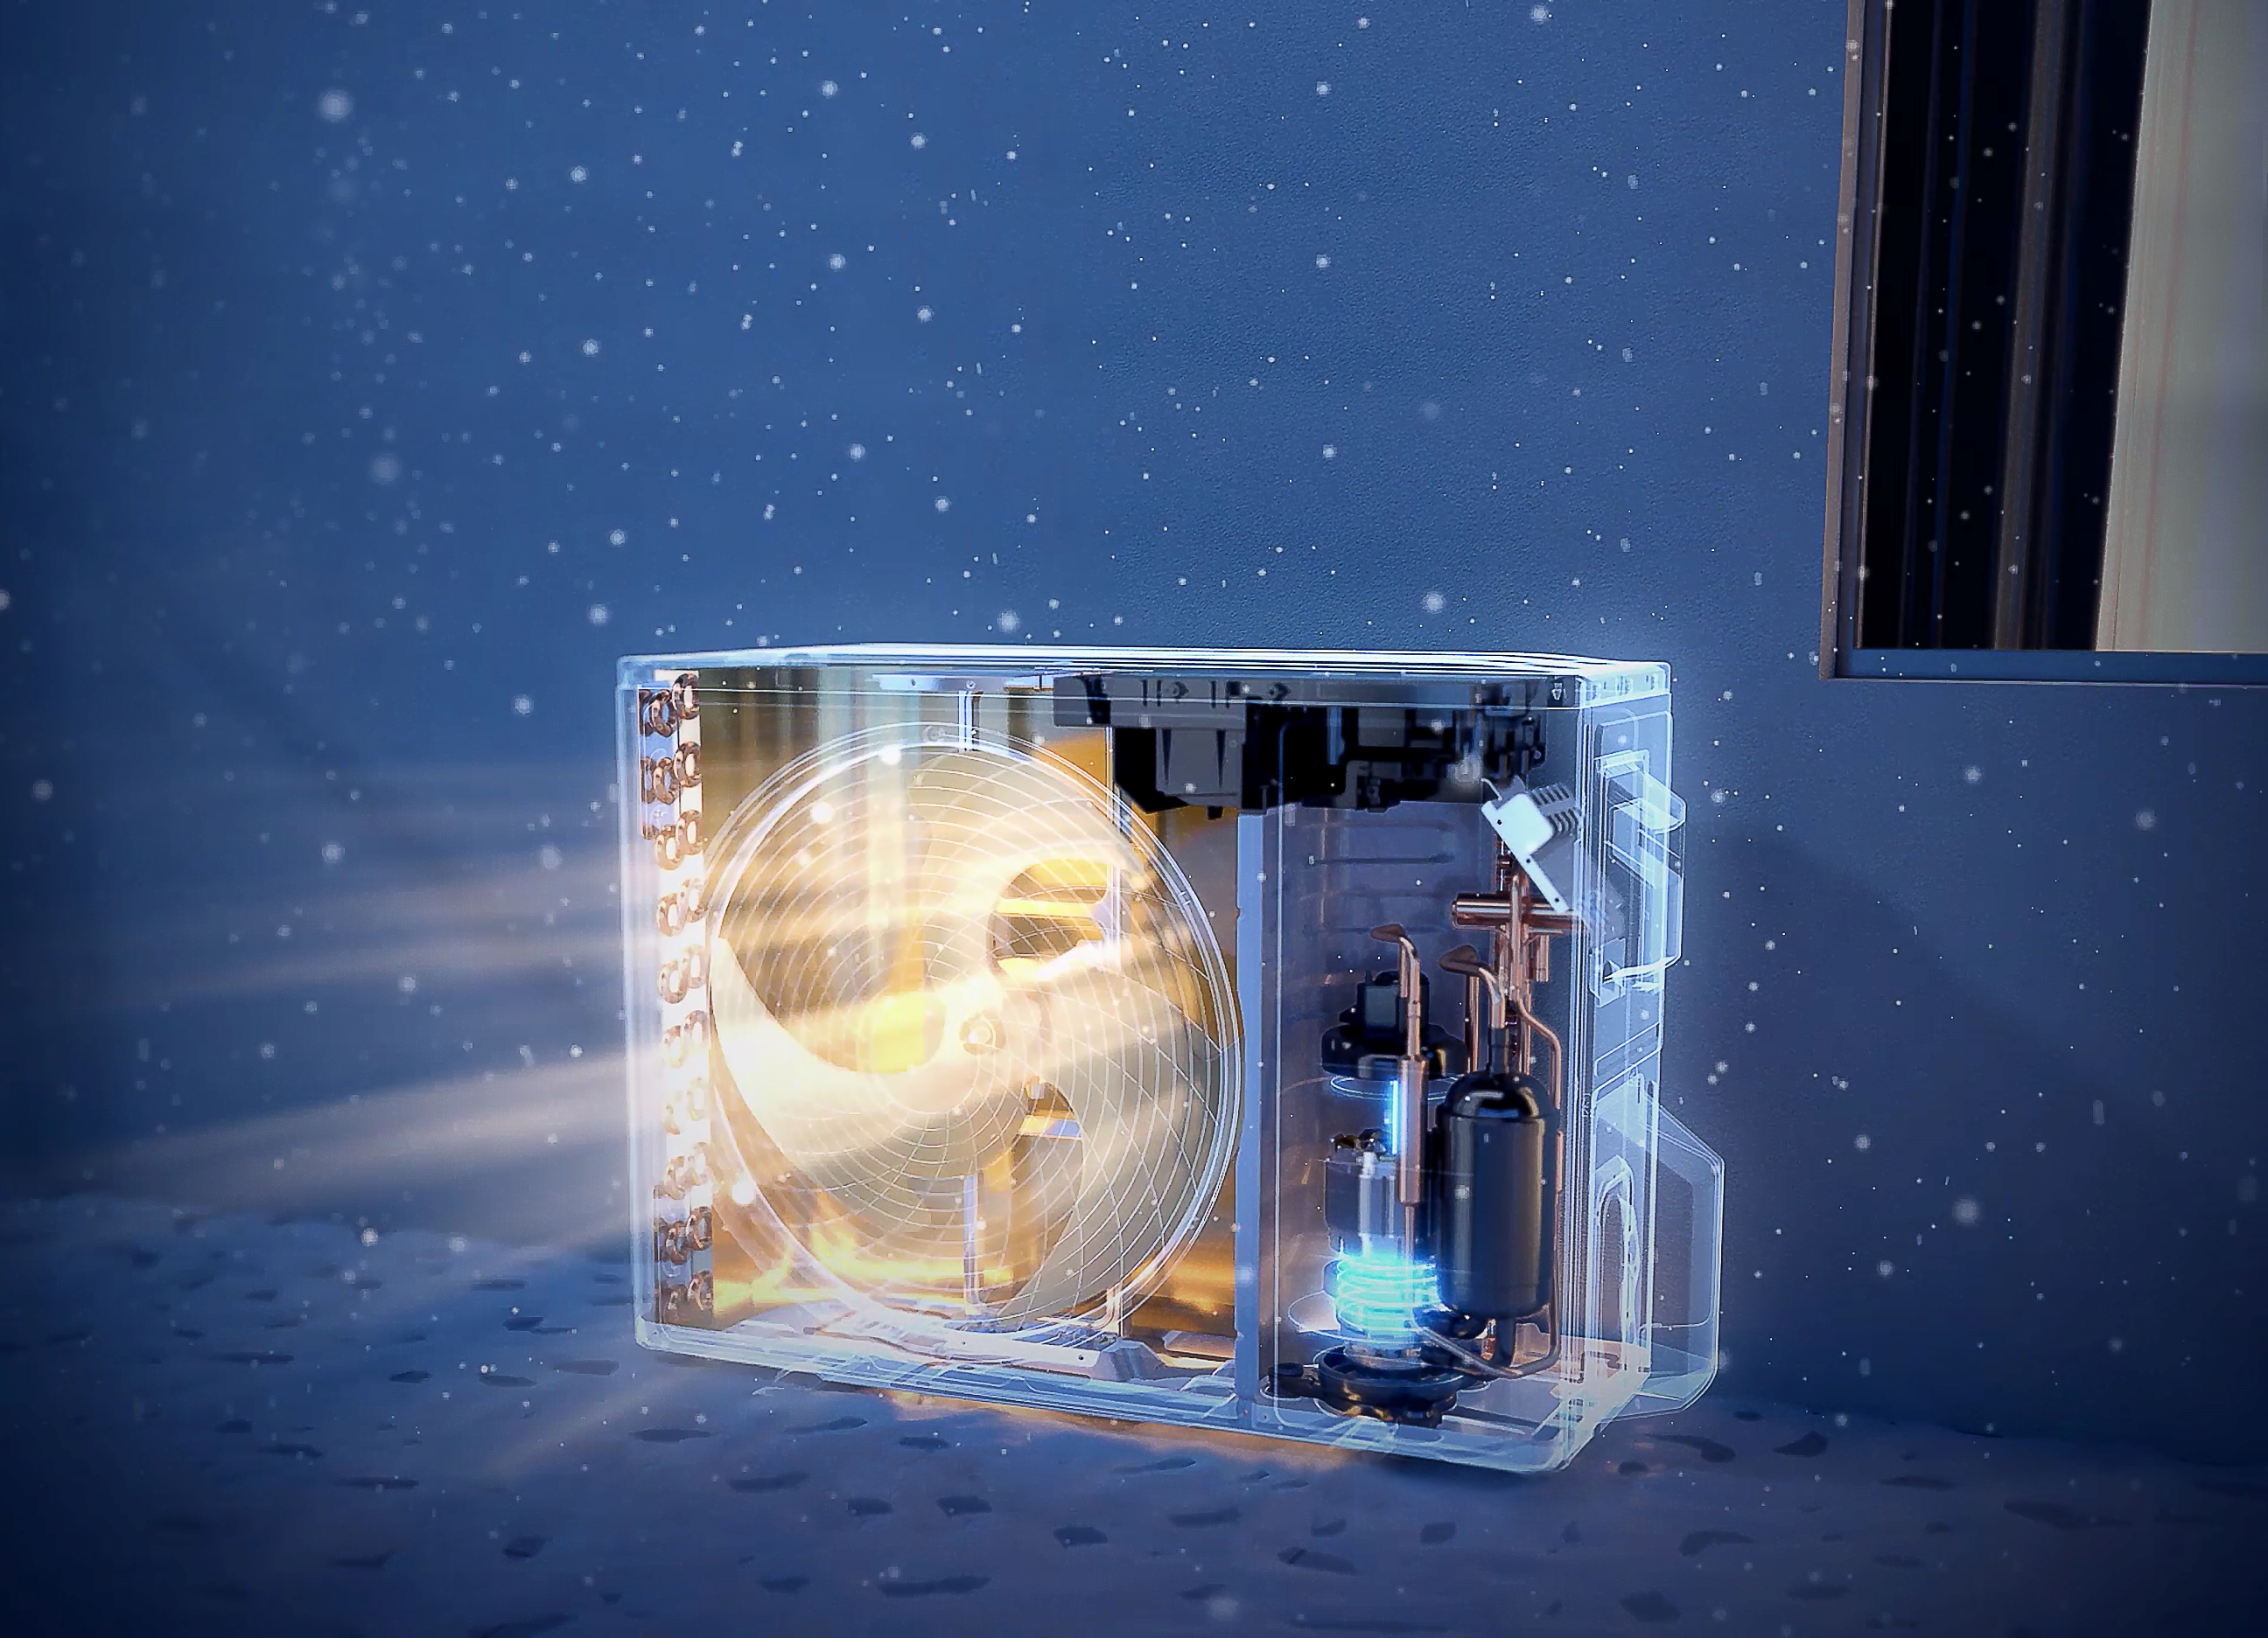
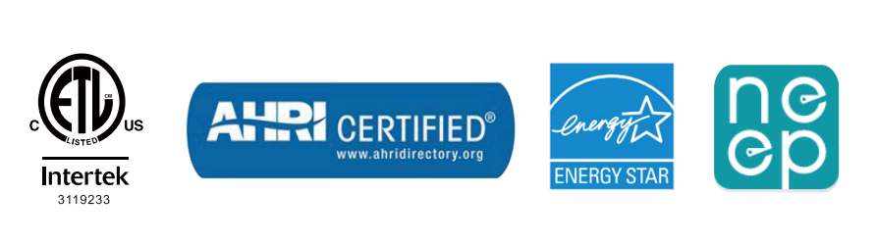
24 SEER2
High Efficiency
AHRI & ETL & Energy Star & NEEP Certificated
HEATING
Heating in -25°C Low Ambient Temperature (12K)

Slide 3
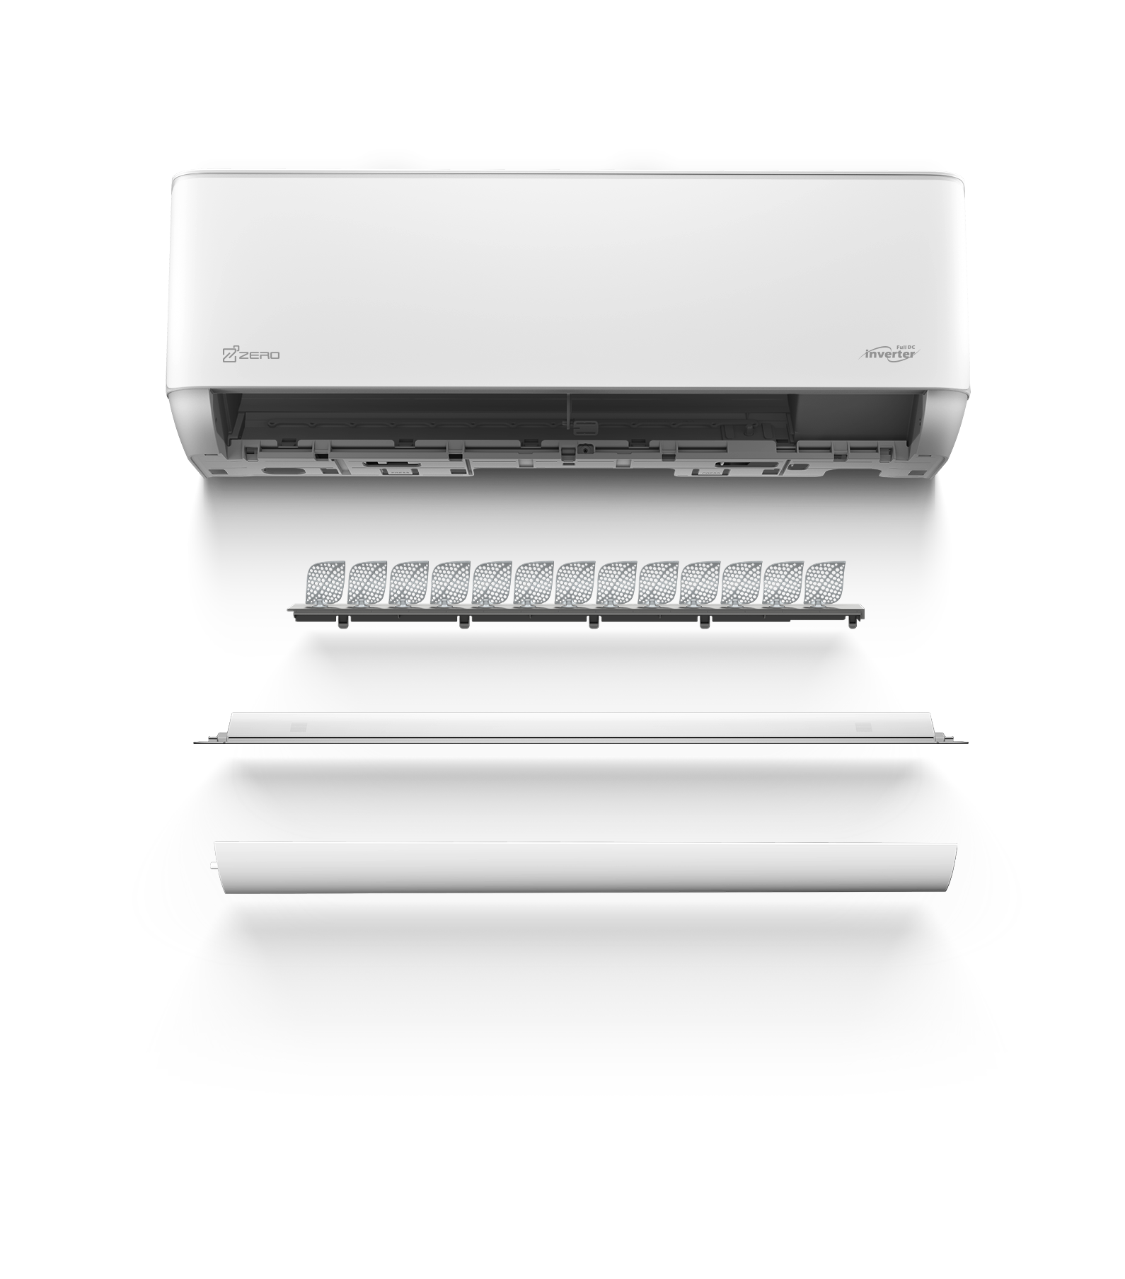
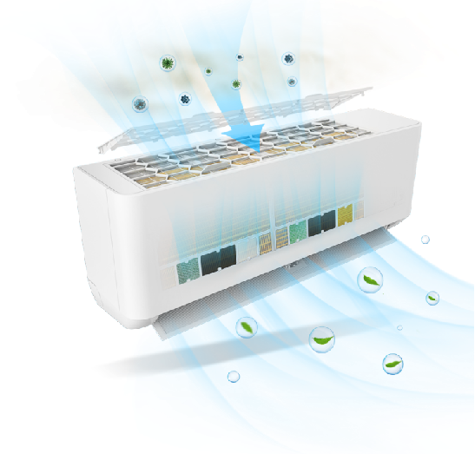
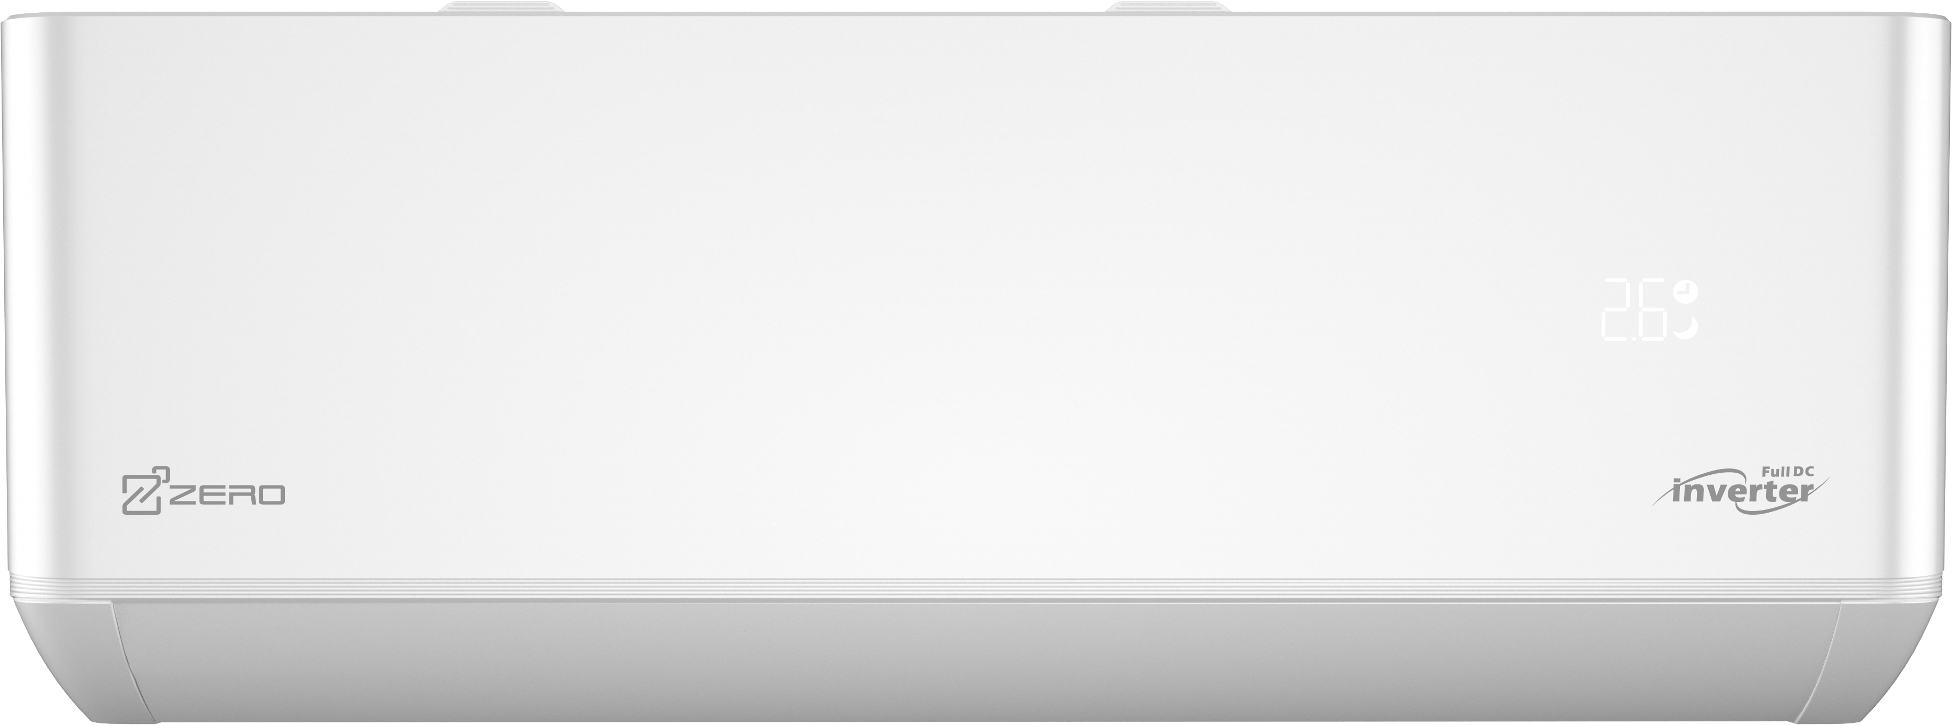
Outstanding Features
Delicate Design
3 Easy
Healthy Comfort

Slide 4
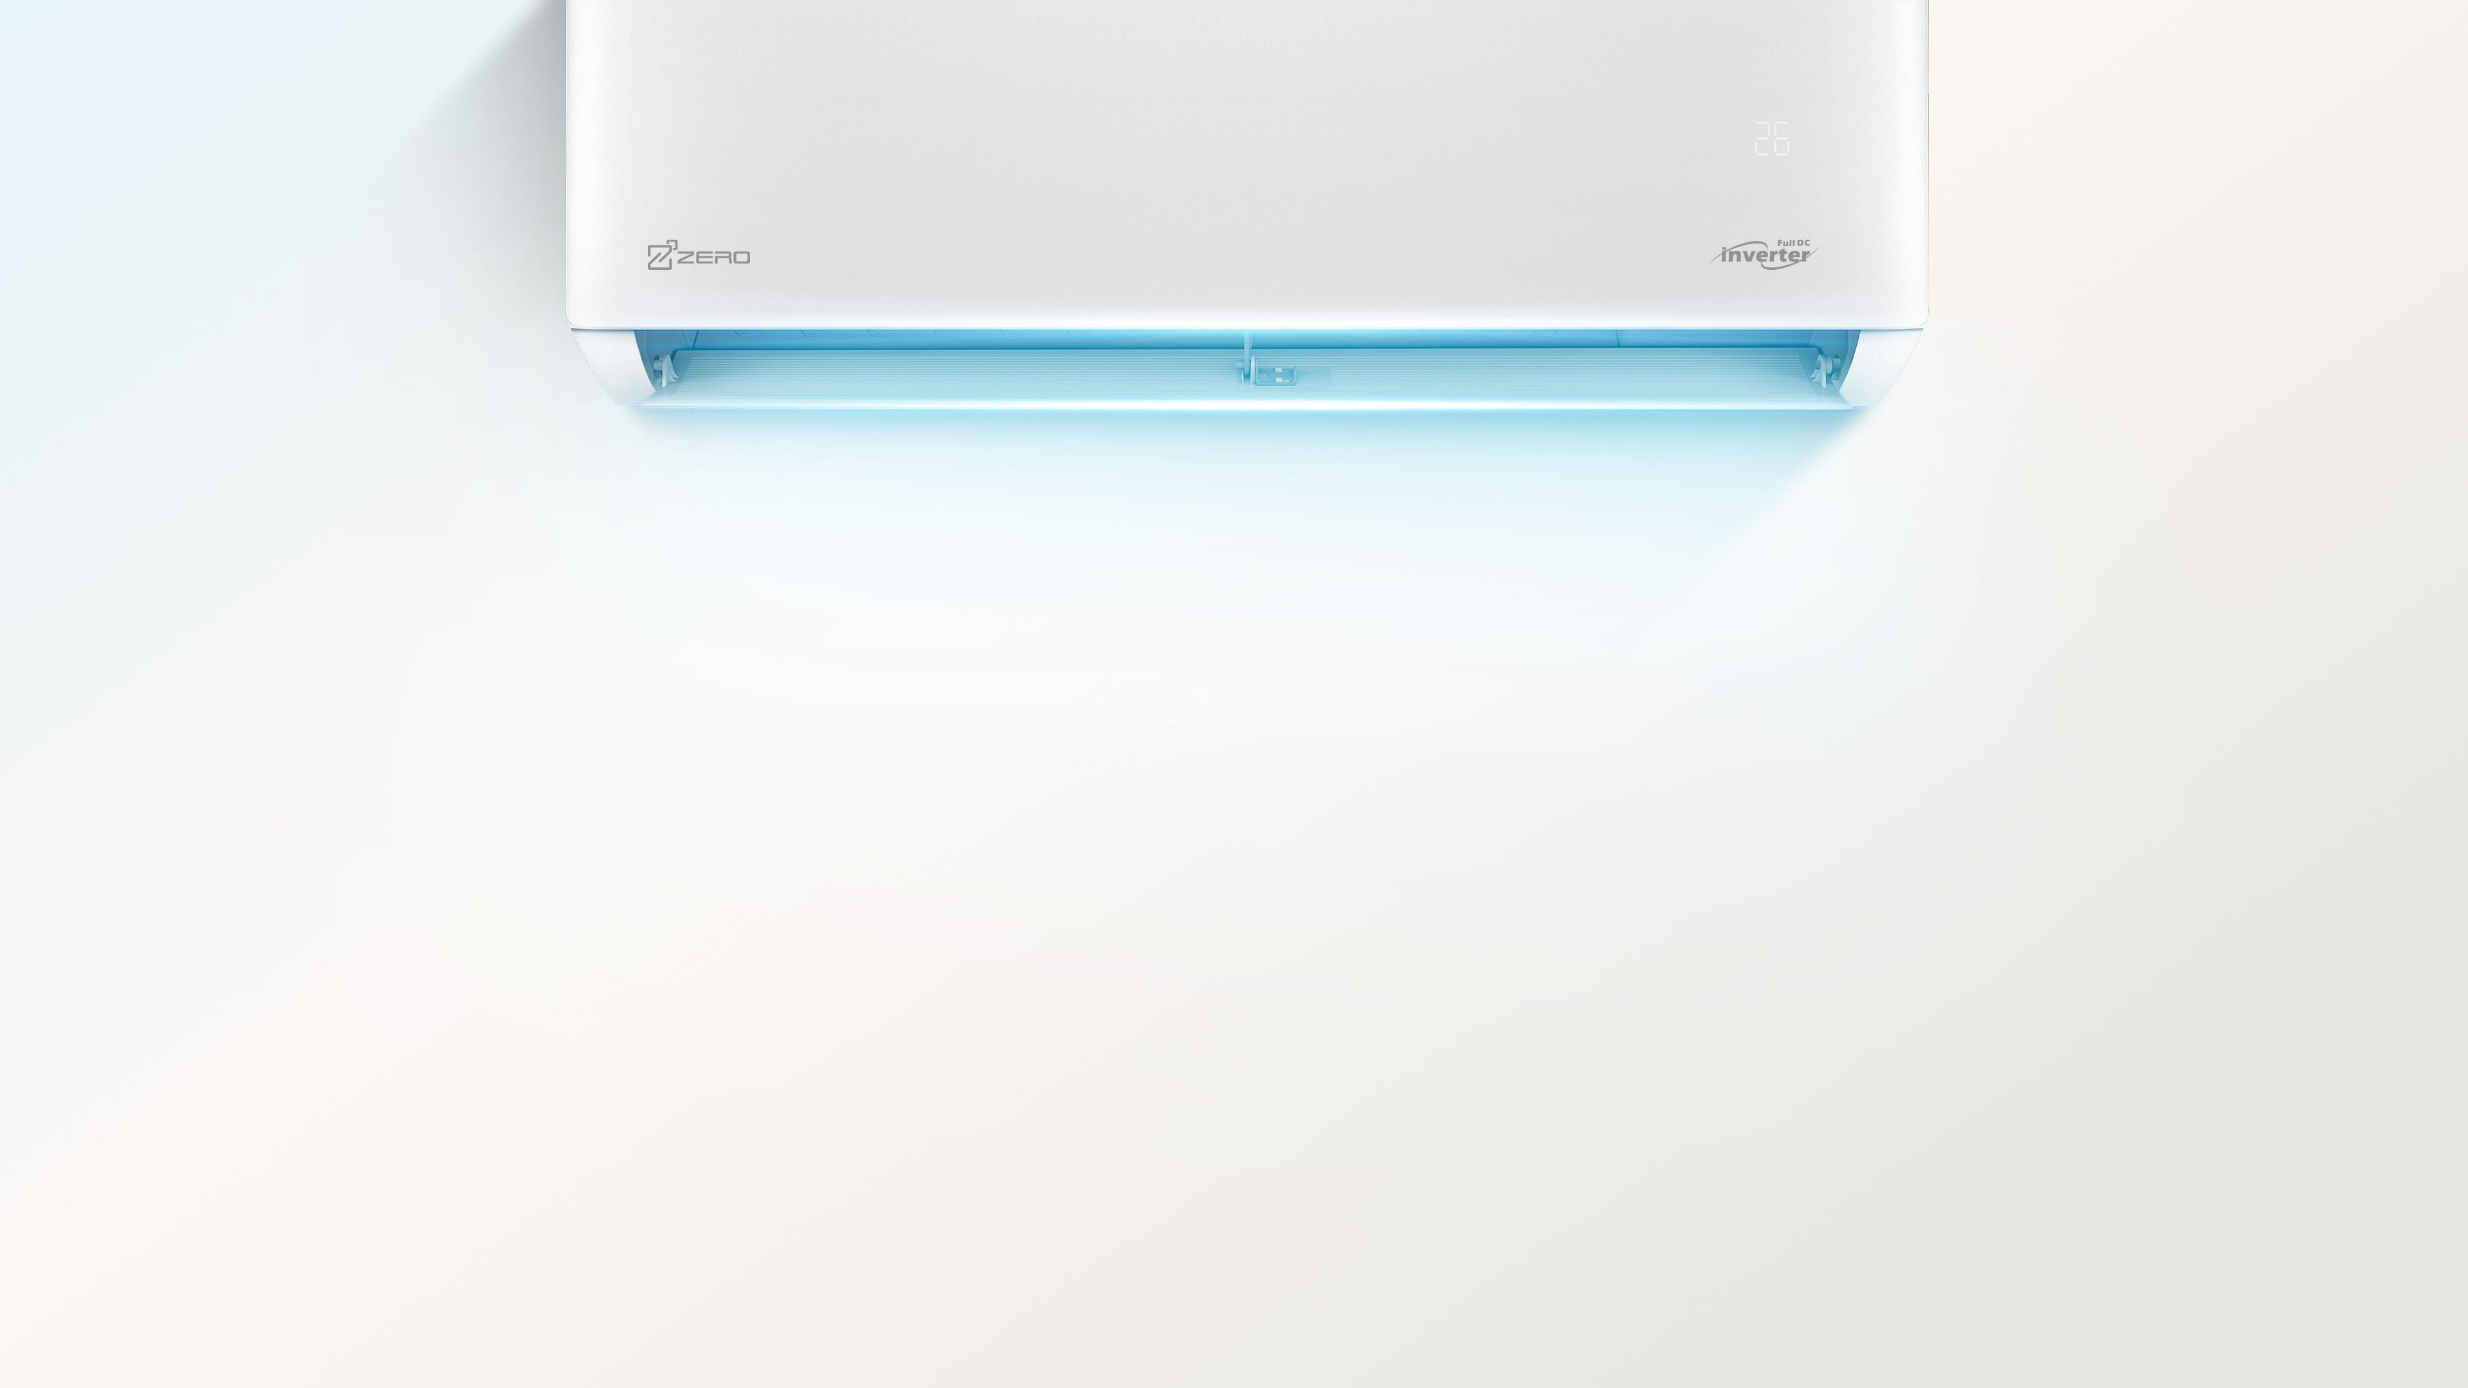
3 EASY
Easy Installation
Easy Maintenance
Easy Assembly

Slide 5
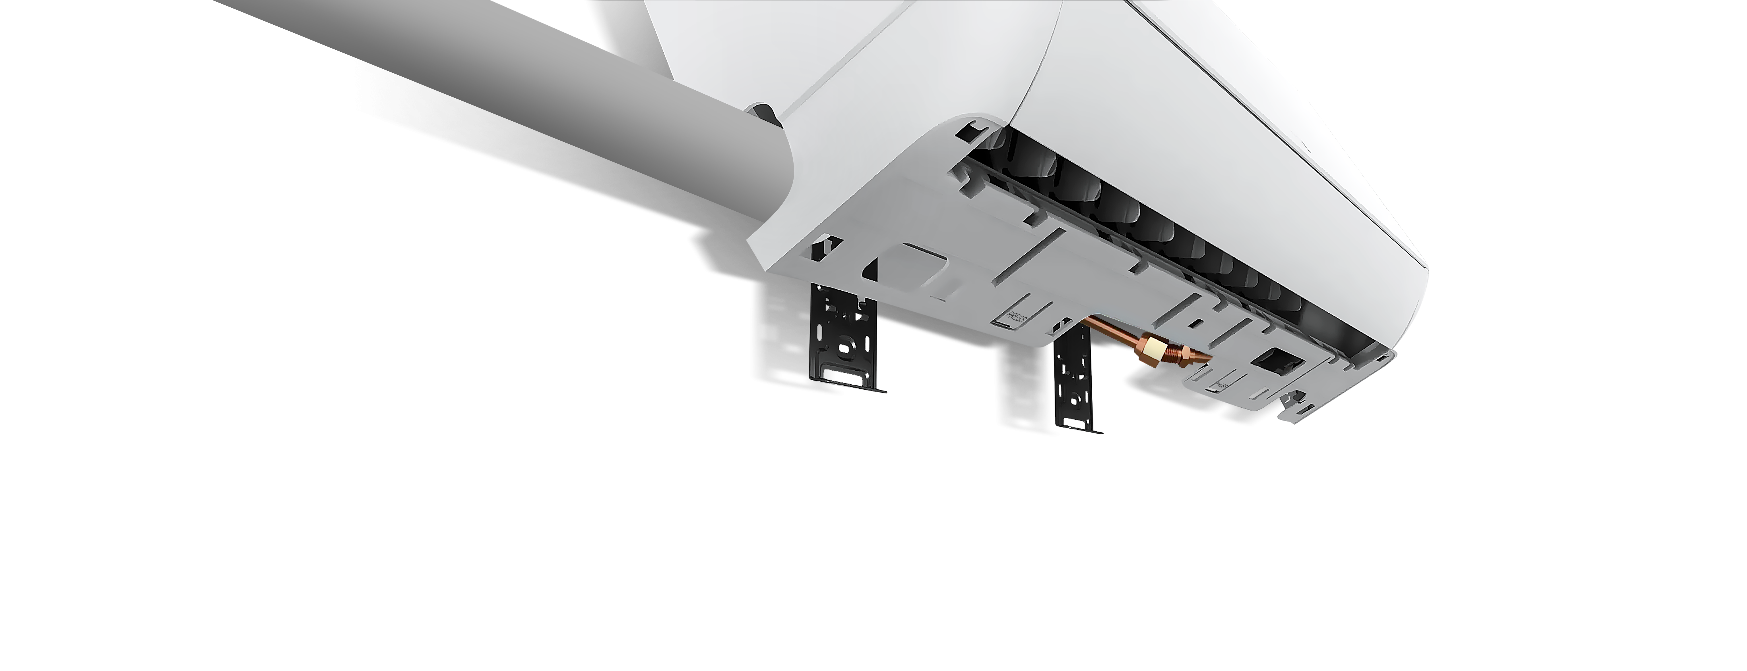
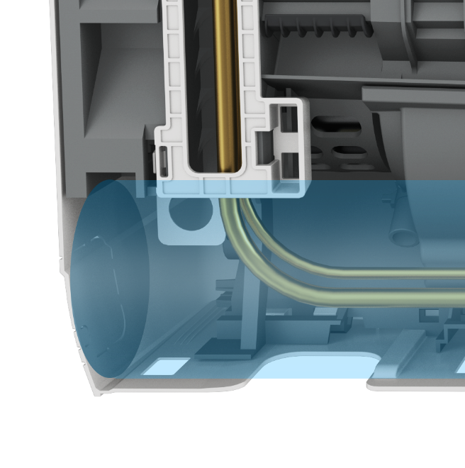
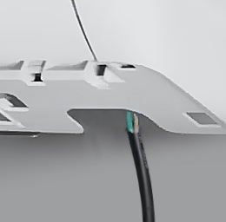
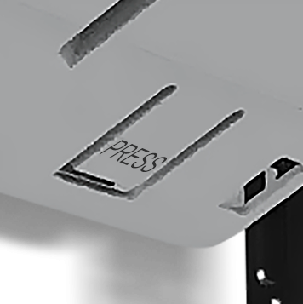

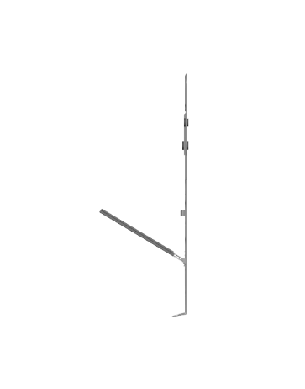

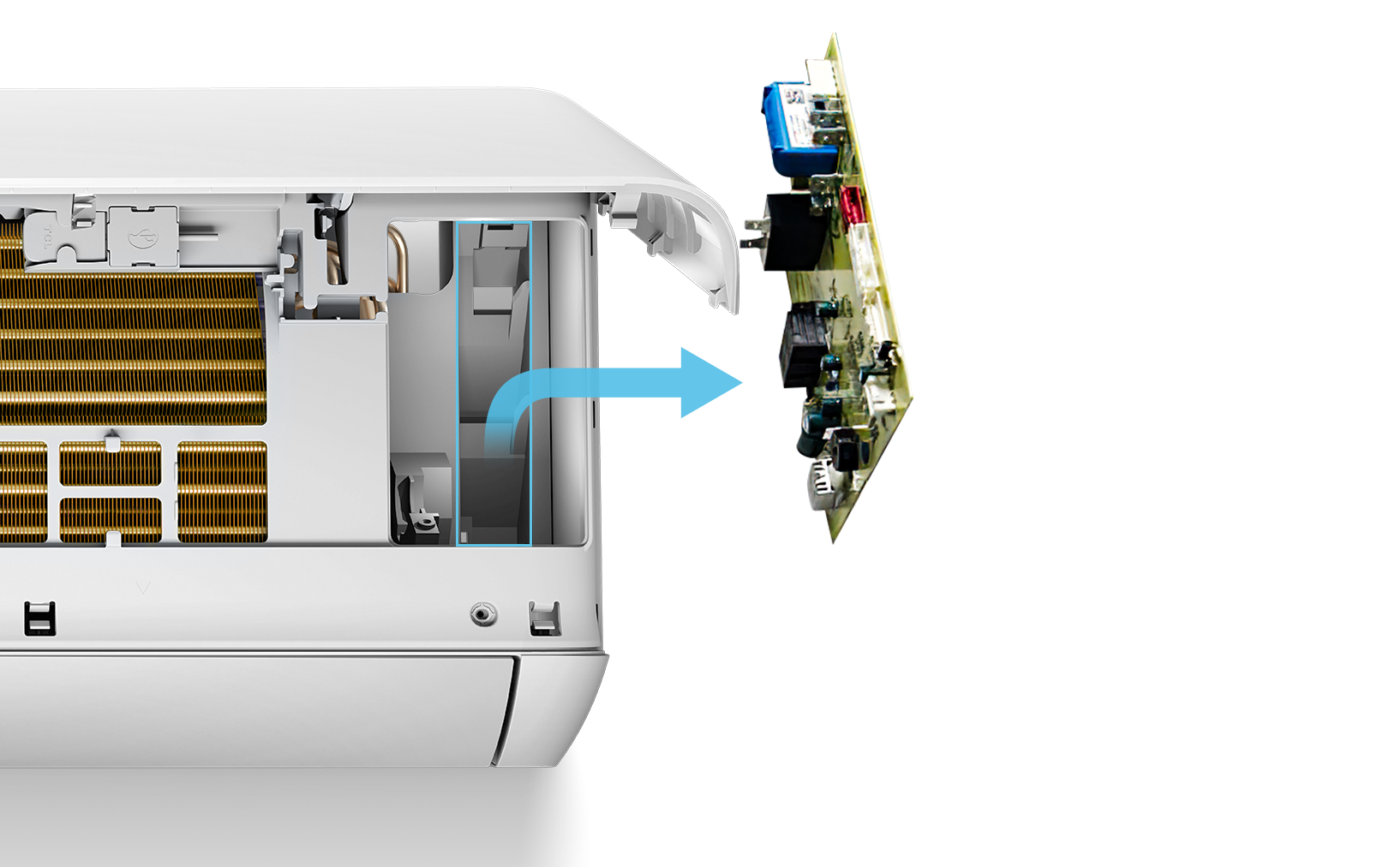
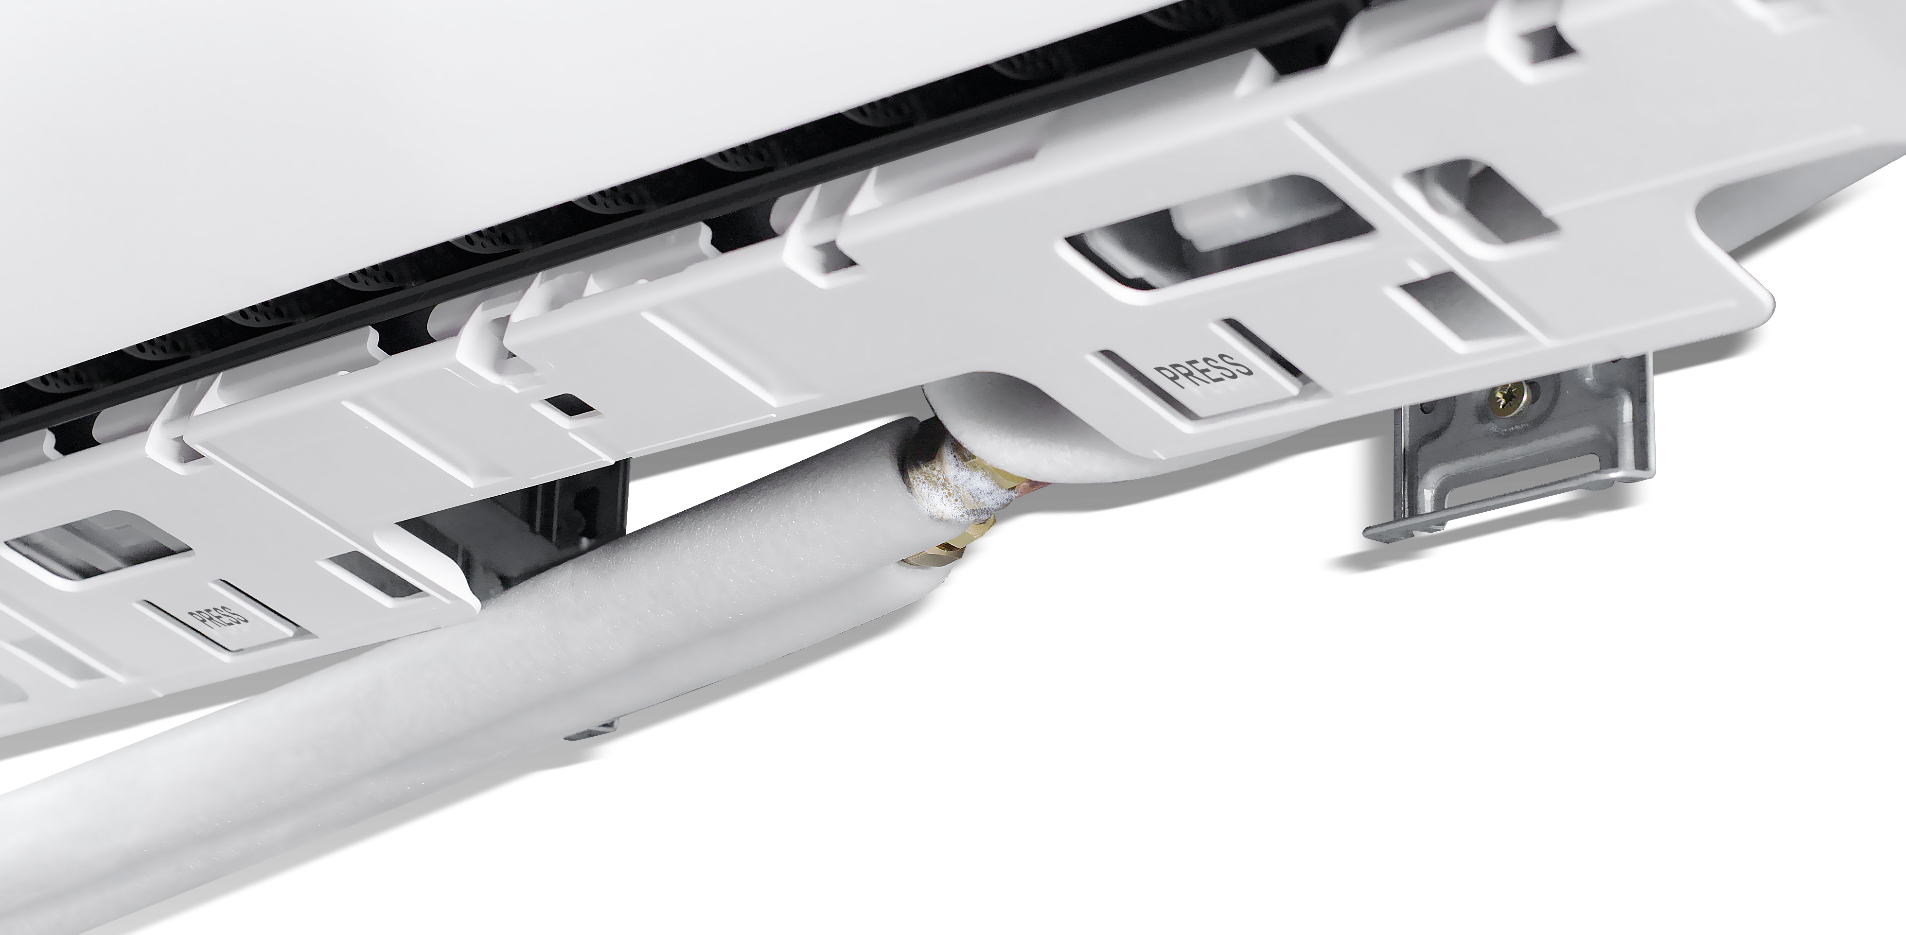
Larger Space for Pipe Connection (≥165mm)
≥165mm
Easy
Installation
Larger Space for Piping (10%)
Window for Easy Wiring
Optional Supporters Available (Gap ≥120 MM)
One PRESS to Detach the Unit From the Plate
Supporters
≥120mm
No Screw Only Buckles
Easy
Assembly
3rd Step
8''
12''
2nd Step
Disassembly
Assembly
1st Step
Quick Replacement of PCB 3 Steps ONLY
Easy Maintenance
STEP 01
Open front panel
Convenient Leakage Check
STEP 02
Take off PCB box cover
Large space for connecting leakage check of indoor unit
STEP 03
Take out PCB for replacement

Slide 6
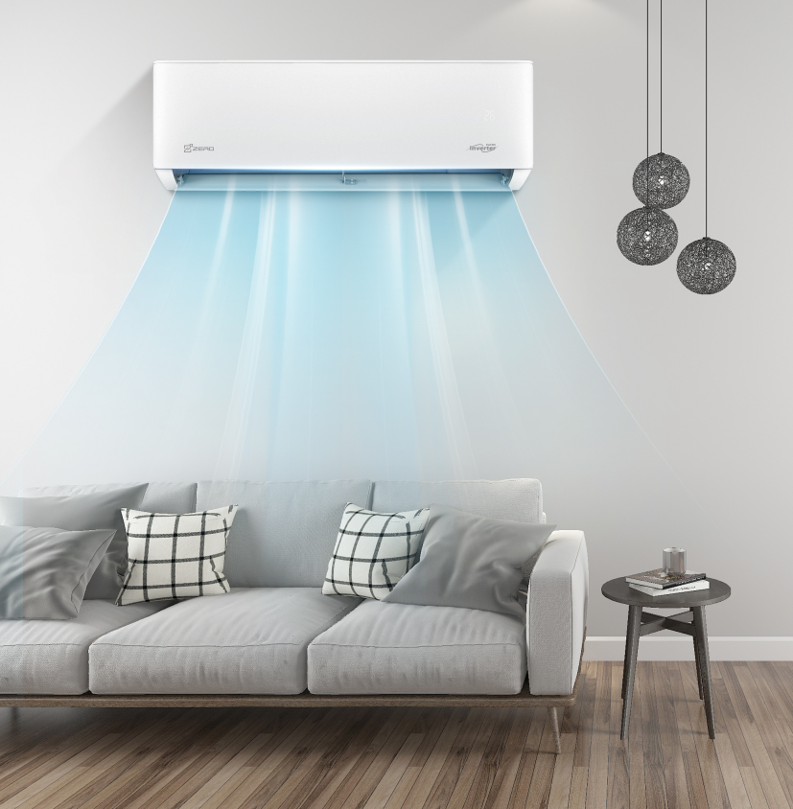
HEALTHY COMFORT
● Turbo Cooling
● Gentle Cool Wind
● B.I.G. Care+
● -25℃ Strong Heating in Low
Ambient Temp.

Slide 7
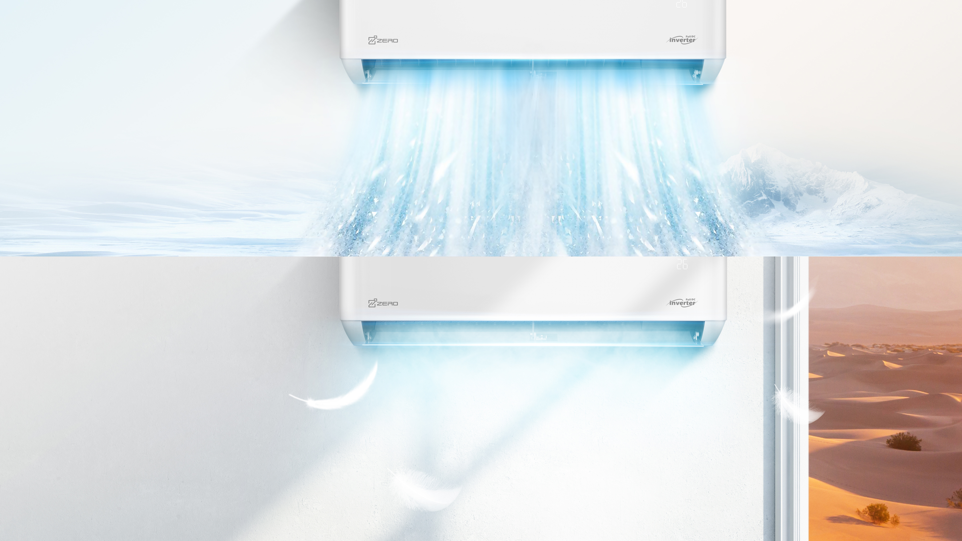
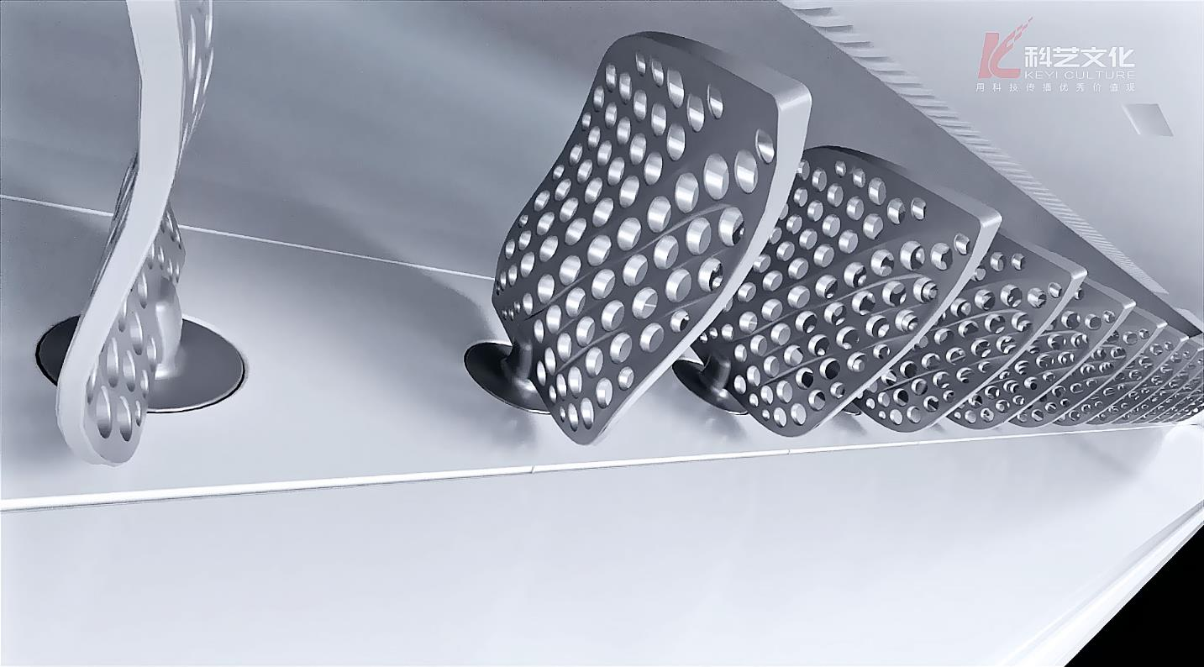
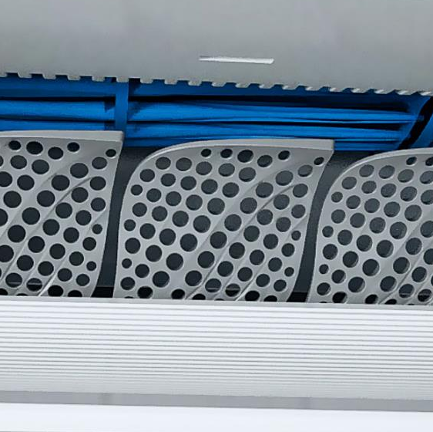
Turbo Cooling
100Hz High Frequency Starting
Rapid Cooling up to 30″ *
Air Volume Increased by 20%
Noise Reduced by 1-2 dB(A)
Gentle Cool Wind
Gentle cool wind blades
* Data from specific sample under testing condition

Slide 8
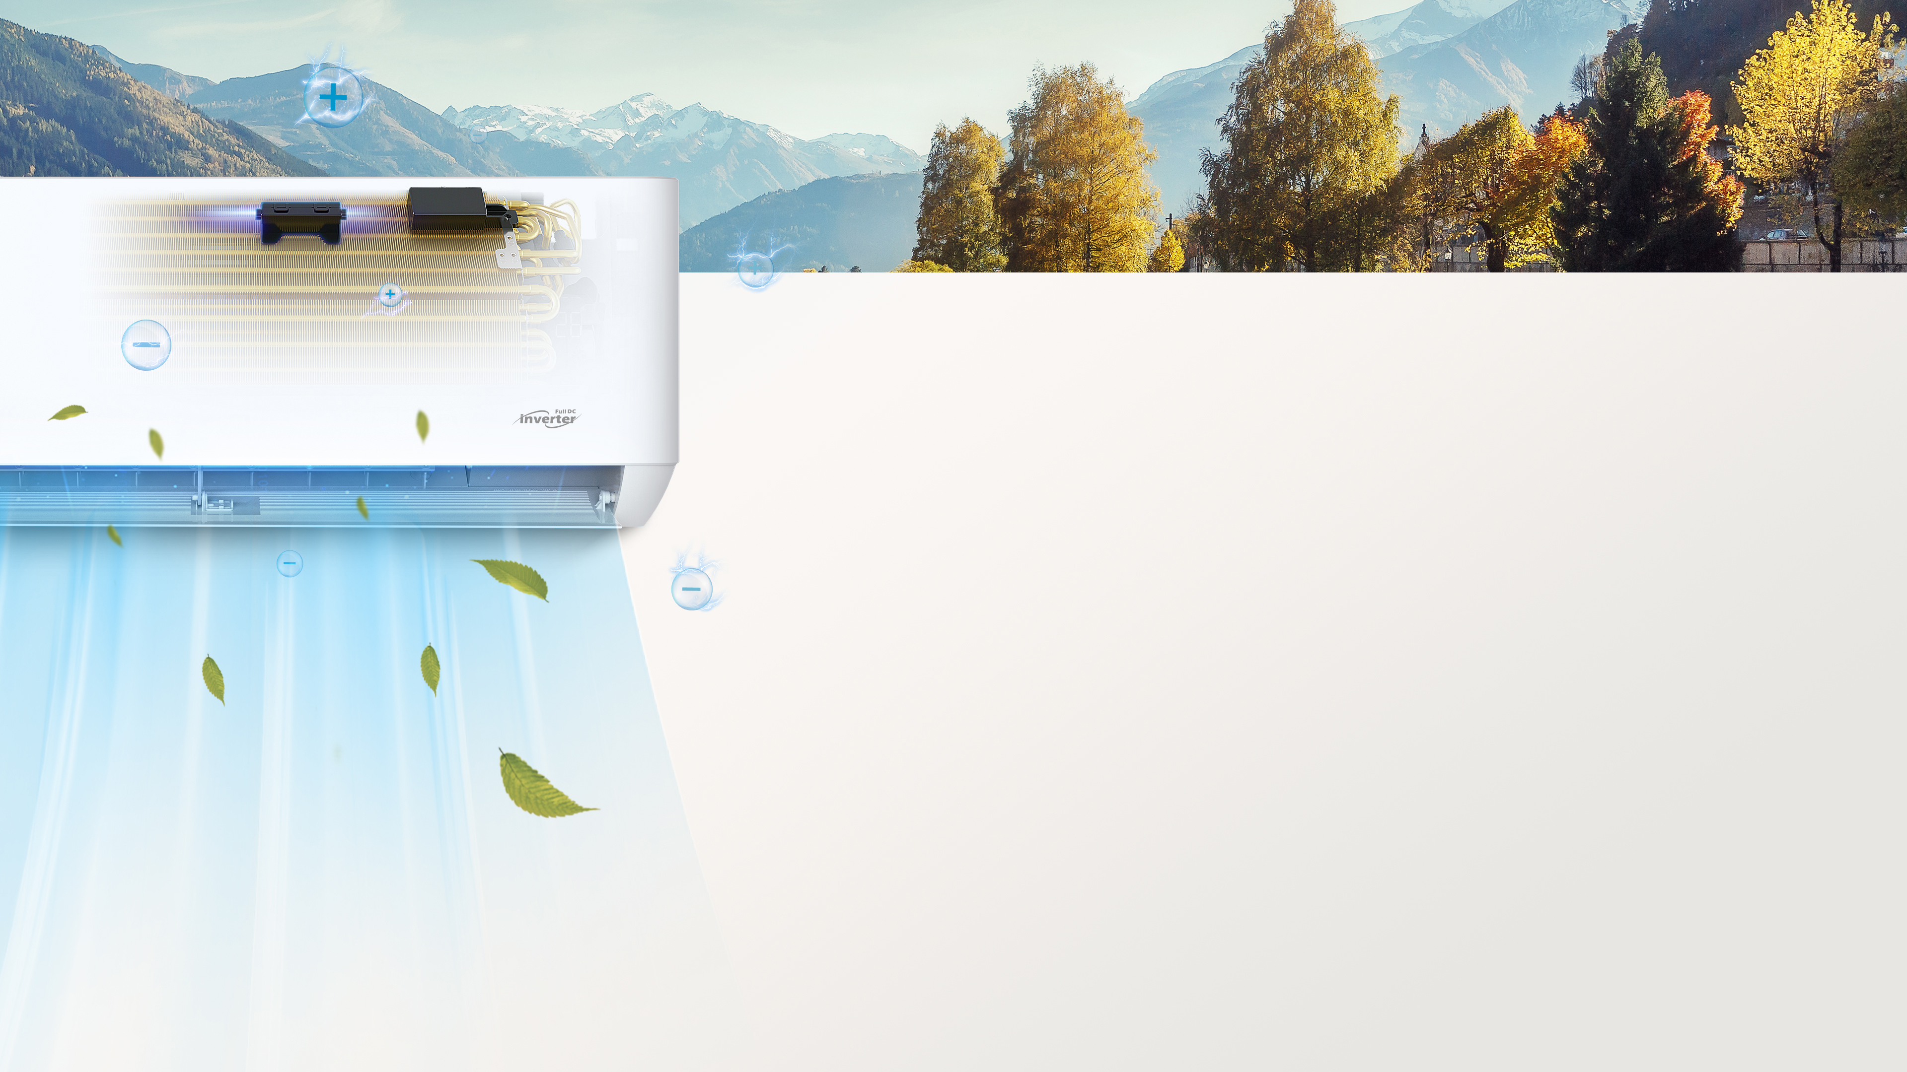

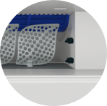
B.I.G. Care
+
Bipolar Ionic Generator & UVC Sterilization Pro
1
2
1
Built-in Bipolar Ionic Generator
Bipolar Ionic Generator is built in the air outlet
Release high energy electronics to ionizing the air
Generate large volume of plasma, atoms, strong oxidization substance, which could damage & kill the bacteria & virus
2
UVC Sterilization
Bacteria Eliminating Rate
> 98.66%
UVC radiation: 240nm-280nm
Kills bacteria by damaging their protein & DNA
* Optional

Slide 9
-25℃ Heating
in Low Ambient Temp
1
Compressor windings are energized to heat the lubricant oil.
2
1
Chassis heating belt applied to preventing frosting of the bottom plate.
2
* Inverter Only

Slide 10
MORE OUTSTANDING FEATURES
Comfort
 | Anti-Cold Air | 6-Fan Speed | Independent Dehumidification | Display On/off | Auto Mode
 | Standard | Standard | Standard | Standard | Standard
 | Smart Airflow | Gentle Cool Wind | Low Temperature Heating（ -25℃）(With Heating Belt) | Rapid Cooling | Rapid Heating
 | Standard | Optional | Optional | Standard | Standard
 | 3D Airflow | 8℃ heating | Comfortable Cooling | I Feel | Low Temperature Cooling -20℃
 | Optional | Optional | Optional | Optional | Standard
Energy saving
 | Eco Energy-saving | Timer | Sleep Mode | AI Inverter Algorithm
 | Standard | Standard | Standard | Standard
Convenience
 | Dual Drainage | Easy-washable Filter | Louver Position Memory | Backlight Display remote control | I Set | WiFi Control | Gate ON/OFF Control
 | Standard | Standard | Standard | Optional | Optional | Optional | Optional
ON/OFF
-20
Health
 | Hidden Display | Refrigerant Leak Detection | Self-cleaning | Healthy Filter | Bipolar Ionic Generator & UVC
 | Standard | Standard | Optional | Optional | Optional
Reliability
 | Auto Restart | Wide Voltage Range Start-up | Intelligent Defrost | Emergency Button | Rust Proof | Self-diagnosis | Children Lock
 | Standard | Standard | Standard | Standard | Standard | Standard | Optional
B.I.G. Care+

Slide 11


Z-MAX US
Hyper Heat
R454B SERIES

